Slide 1
Exploring and Predicting E-commerce Customer Churn and Baseline Classifiers
Course number: COMP 7/8150 Name: Janaki Samba Moorthy

Slide 2
Contents
Problem Definition
Background Study
Why are RFM Metrics important
Methodology
Dataset Overview
EDA Findings
Feature Engineering, Outlier Detection & Data Preparation
Feature Selection Refinement and Refinement Journey
Final Modelling Pipeline
Results
Insights
Conclusion
Future Scope
References

Slide 3
Problem Definition
E-commerce companies face significant revenue loss due to customer churn (customers leaving or becoming inactive).
Retaining existing customers is more cost-effective than acquiring new ones.
Objective of the Project: Predict which customers are likely to churn using historical data.
Revenue & Profitability Impact:
E-commerce churn exceeds 60% annually
Repeat customers represent only 21% of customer base but generate 44% of total revenue
5% increase in retention → 25-95% increase in profit
Losing high-value customers directly impacts Customer Lifetime Value (CLV)
Acquisition vs. Retention Economics:
Acquiring new customers is 5-25× more expensive than retaining existing ones
Repeat customers spend 67% more than new customers
Probability of selling to existing customer: 60-70% – New prospects: only 5-20% success rate​
Existing customers are 50% more likely to try new products
Loyal customers spend 31% more on average

Slide 4
Background Study
Factors Affecting Churn
Customer Churn: Customer churn occurs when a customer stops engaging or making purchases for a certain period.
Studies show that monthly churn rates in e-commerce are often between 5% and 10%, depending on the industry and customer type.
For annual churn, this can translate to 20–30% of customers leaving in a year.
Location
Cart Abandonment rate
Time spent in sessions
Time between purchases
Product Preferences
Recency
Approaches to Churn Prediction: Machine Learning Models: Logistic Regression, Random Forest, SVM, Gradient Boosting. Feature Engineering: RFM analysis, temporal trends, behavioral metrics. Evaluation Metrics: Accuracy, F1-score, Confusion Matrix, Cross-Validation.
Churn
Purchasing Patterns
Monetary
ATCs
Frequency
CSAT
Session Activity
CTRs

Slide 5
Why are RFM Metrics important?
What RFM Measures:
Helps in
Early warning signals for at-risk customers before they churn​
Directly captures behavioral patterns that indicate churn likelihood
Actionable Segmentation:
Creates distinct customer groups: Champions, At-Risk, Loyal, Lost​
Each segment receives targeted retention strategies based on its profile​
Metric | What | Indication
Recency | How recently did customer make a purchase? | Current engagement indicator​
Frequency | How often do they buy? | Loyalty & repeat purchase behavior​
Monetary | How much revenue do they generate? | High-value customer identification​
High value High Frequency | CAMPIONS Highest Priority Top Spenders
High value Low Frequency | AT RISK Declining Engagement Critical Attention
Low Value Low Frequency | LOST CUSTOMERS Nearly Churned Low Retention Value
Notes:
REFERENCES:
**** Sobot (2025). "Understanding the Average Churn Rate for Ecommerce Stores - Trends 2024-2025." https://www.sobot.io/article/average-churn-rate-for-ecommerce-stores-trends-2024-2025/​
**** Yotpo (2025). "Customer Acquisition Vs. Retention: Which Drives Profit?" https://www.yotpo.com/blog/cost-of-customer-acquisition-vs-retention/​
**** Yotpo (2025). "Customer Acquisition Vs. Retention: Which Drives Profit?" - Bain & Company Research Citation. https://www.yotpo.com/blog/cost-of-customer-acquisition-vs-retention/​
**** Envive AI (2024). "36 Customer Retention Statistics in eCommerce in 2025." https://www.envive.ai/post/customer-retention-in-ecommerce-statistics​
**** Yotpo (2025). "Customer Acquisition Vs. Retention: Which Drives Profit?" - Key Statistics Section. https://www.yotpo.com/blog/cost-of-customer-acquisition-vs-retention/​
**** Propel (2025). "RFM Analysis for Customer Segmentation and Enhanced Retention." https://www.trypropel.ai/resources/rfm-analysis-customer-segmentation-strategies​
**** HubSpot (2024). "RFM Analysis: A Data-Driven Approach to Customer Segmentation." https://blog.hubspot.com/service/rfm-analysis​
**** Omniconvert (2024). "A Comprehensive Guide to the RFM Model." https://www.omniconvert.com/blog/rfm-model/​
**** OWOX (2024). "RFM Analysis: Learn about Customers and RFM Segmentation." https://www.owox.com/blog/use-cases/rfm-analysis​

Slide 6






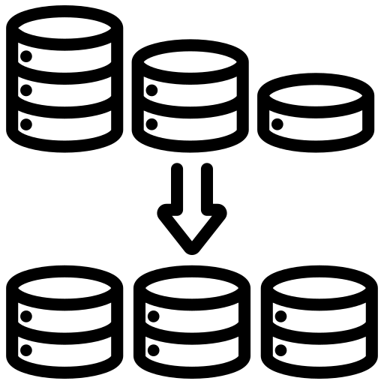

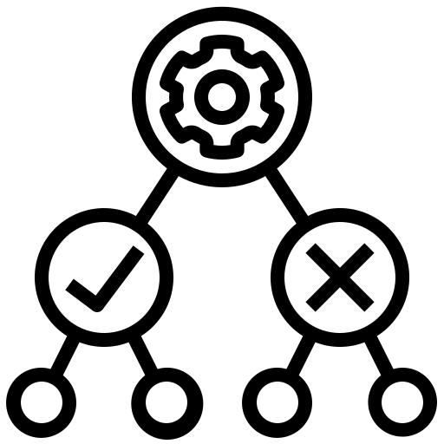



1. DATA PREPARATION & PREPROCESSING
Methodology
Data Ingestion
Data Preprocessing
EDA
Feature Engineering
Train & Test Split
Data Cleaning & Normalization
Outlier Detection
Feature Selection
Model Evaluation & Validation
Outlier Detection & performance
Model Comparison & Interpretation
Model Selection
Business Insights -> Deployment and Monitoring
Notes:
The above figure shows the end-to-end methodology applied in this project.
Data Ingestion: A UK retailer-based e-commerce dataset was chosen and ingested. The data was at the transaction, but every row was at an aggregated level, so the last transaction for every user was considered.
Data Preprocessing: This step creates a consistent analytic base table ready for exploration and modeling. There were no missing data fields and outliers were detected and removed using KNN.
EDA: Exploratory analysis summarizes churn rate, class imbalance, and distributions of key variables such as recency, frequency, and monetary value. Correlations and basic visualizations reveal skewness, outliers, and early signals of which behaviors differ between churned and retained users.
Feature Engineering: RFM variables are created alongside richer temporal, behavioural, and latent features (e.g., recency of sessions, monthly purchase lags, and latent factors from embeddings). These engineered features capture both short-term patterns and long-term value that drive churn risk.
Outlier Detection: Potential anomalies are identified by examining extreme values and, later, by using K‑nearest‑neighbour distances in feature space. Synthetic outliers are also injected to stress‑test model robustness and the effectiveness of the detection strategy.
Data Cleaning and Normalization: Extreme values are trimmed or handled, and continuous features are standardized using z‑score scaling so that models like SVM and Logistic Regression treat all variables on a comparable scale. This improves numerical stability and convergence during training.
Train and Test Split: A stratified 80/20 split on users is performed to preserve the churn proportion while preventing information leakage between train and test. The scaler and any other transformations are fit only on the training data and then applied to the test data.
Feature Selection: Multiple RFM‑only variants are first evaluated, followed by a forward wrapper method over all 275 features using Logistic Regression as the evaluation model. The wrapper selects 40 high-impact features that maximize test accuracy while reducing dimensionality and overfitting risk.
Model Selection: Several algorithms—Logistic Regression, Logistic Regression with SMOTE, SVM, and Random Forest—are trained on the selected features. SVM is chosen as the final model because it achieves very high accuracy with stable cross-validation performance and captures non‑linear relationships in the data
Model Evaluation: Models are evaluated using accuracy, F1‑score, and confusion matrices on the held-out test set, and validated with 3-fold and 5-fold cross-validation on the training data. Mean and standard deviation of CV accuracy quantify generalisation and stability across different splits.
Outlier Detection and Performance: The test set is evaluated in three scenarios: clean, with synthetic outliers injected, and after KNN-based outlier removal. Comparing metrics across these scenarios shows how much performance degrades under OOD noise and how effectively KNN restores accuracy once anomalies are removed.
Model Comparison and Interpretation: Performance of all models and scenarios is summarized in tables, highlighting that RFM-only methods reach 60–75% accuracy, while the wrapper‑selected SVM and other models exceed 99%. Feature importance and confusion patterns are used to explain which behaviours are most predictive and how different models trade off errors.
Business Insights: The final model’s outputs are translated into actionable insights such as identifying high-risk customers, key churn drivers (e.g., long inactivity, declining revenue), and potential retention levers. These insights support targeted campaigns that prioritize users with high predicted risk and high expected revenue impact.
Deployment and Monitoring: A production plan scores users regularly using the trained SVM model, feeds high-risk segments to CRM systems, and monitors performance over time. Scheduled retraining, drift detection, and dashboard tracking ensure the churn system remains accurate and aligned with evolving customer behaviour.

Slide 7
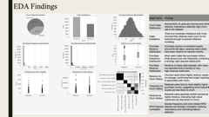
Dataset Overview
Dataset Preprocessing
,
Source | A Kaggle dataset of UK ecommerce platform
Rows | 112,610
Columns | 276
Key Data Fields | user_id target_event purchase_recency_mean session_recency_mean inter_purchase_time_mean purchase_count_sum session_number_sum click_count_sum purchase_revenue_sum target_customer_value
Findings from EDA
Aggregation: Computed user-level statistics (mean, sum, min, max, standard deviation, coefficient of variation) across all transactions for each user; analysis is performed at user level.
Last Transaction Consideration: For every user, the most recent transaction is identified and used to define the churn label and target-period outcomes.
Target Label Extraction: Churn label (target_event) is extracted from the last transaction per user.
Feature Merge: Aggregated RFM and behavioral features are merged with the target label by user_id.
Resulting Dataset: 21,605 user-level rows with 275 modeling features (excluding identifiers, time fields, and target).
Data Quality: No major missing values observed, so the dataset is ready for further analysis and modeling.
TARGET VARIABLE WAS CHOSEN BASED ON THE LAST TXN OF THE USER AND SO WERE THE FEATURES.

Slide 8
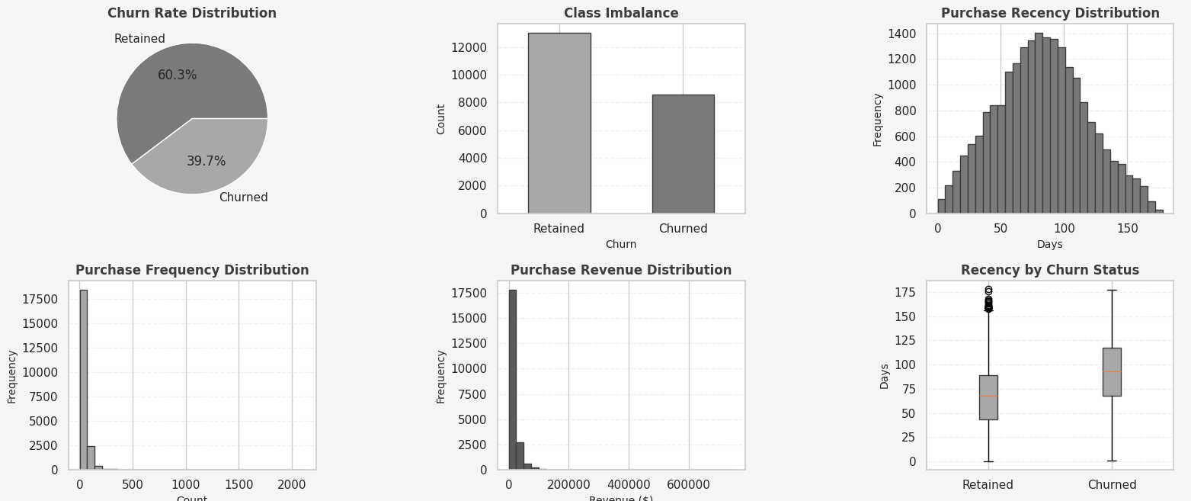
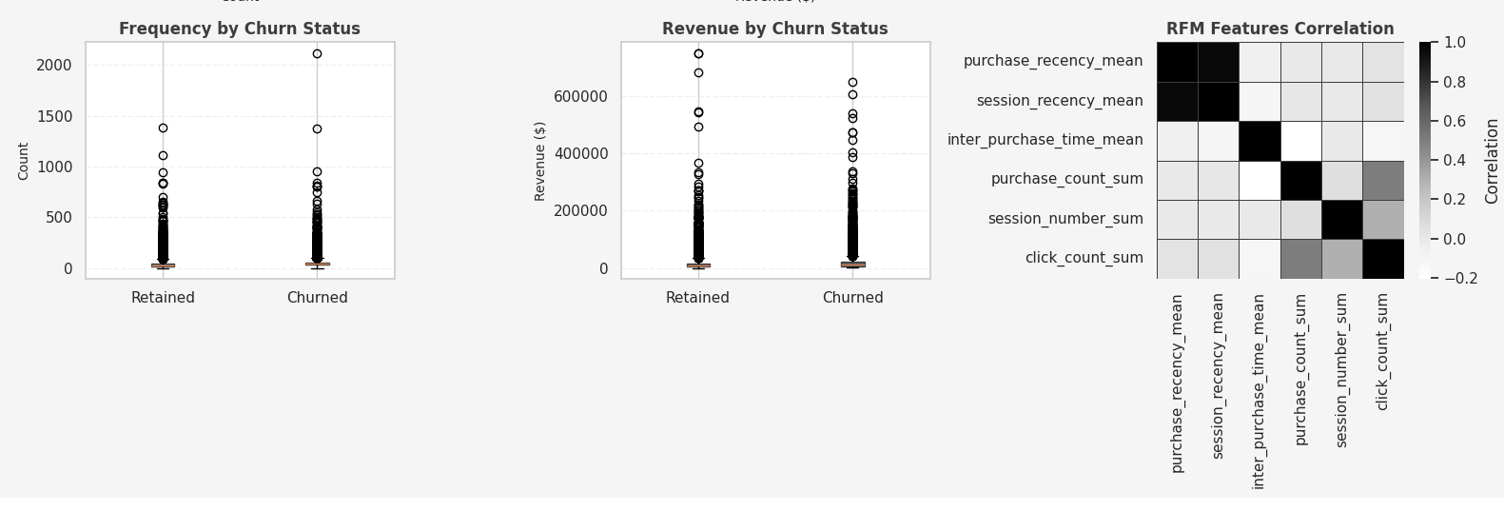
EDA Findings
Graph name | Findings
Churn Rate Distribution | Around 60% of users are churned and 40% retained, indicating a relatively high churn rate in the dataset. ​
Class Imbalance | There is a moderate imbalance with more churned than retained users, but it is not extreme enough to prevent effective modeling. ​
Purchase Recency Distribution | Purchase recency is centered roughly around 80–90 days, meaning many users have been inactive for several months. ​
Purchase Frequency Distribution | Most users make few purchases while a small group buys very frequently, producing a strongly right-skewed distribution. ​
Purchase Revenue Distribution | Revenue is highly right‑skewed, with many low spenders and a handful of very high‑revenue customers. ​
Recency by Churn Status | Churned users show higher recency values on average, confirming that longer inactivity is associated with churn. ​
Frequency by Churn Status | Retained users tend to have slightly higher purchase counts, suggesting more frequent buyers are less likely to churn. ​
Revenue by Churn Status | Retained users generally exhibit somewhat higher revenue, indicating high‑value customers are less prone to churn. ​
RFM Features Correlation | Several frequency and click-related RFM features are strongly correlated, implying redundancy and motivating feature selection
Notes:
Data Preprocessing
Aggregation: User-level statistics computed (mean, sum, min, max, stddev, coefficient of variation)
Target Label Extraction: Churn label (target_event) extracted from last transaction per user
Feature Merge: Aggregated RFM and behavioral features merged by user_id
Result: 21,605 user-level rows, 275 modeling features (excluding id/time/target)
Data Quality: No major missing values reported; ready for modeling
Exploratory Data Analysis (EDA)
Churn Distribution:
Churned users: 13,021 (60.27%)
Retained users: 8,584 (39.73%)
Class imbalance: 1:1.52 ratio (moderate, requiring balanced class weights)
Key Feature Insights:
Purchase Recency: Mean ~82–83 days; churned users show higher recency (more inactive)
Purchase Frequency: Highly right-skewed (mean ~48, range 1–2,120); retained users have higher frequency
Purchase Revenue: Strongly right-skewed (mean ~$16.7K, max >$750K); retained users tend to have higher revenue
Session Activity: Extreme outliers present (max ~231M sessions), indicating data quality issues and need for scaling
Feature Correlations:
Strong positive correlation between purchase_count_sum and click_count_sum
Recency features are highly correlated, indicating redundancy
RFM metrics show expected relationships with churn (high recency/low frequency → higher churn)
Data Characteristics:
Heavy skewness across RFM metrics requires standardization and potential log-transformation
Outliers present in behavioral features (sessions, revenue) motivate KNN-based detection and removal
Feature scale varies dramatically (−148 to 231M), requiring StandardScaler normalization
Visual Summary (9 EDA Plots)
Churn Rate Distribution (pie): 60% churned vs. 40% retained
Class Imbalance (bar): More churned than retained, but moderate imbalance
Purchase Recency (histogram): Bell-shaped around 80–90 days
Purchase Frequency (histogram): Right-skewed, most users are low-frequency buyers
Purchase Revenue (histogram): Highly right-skewed with extreme high spenders
Recency by Churn Status (boxplot): Churned users have higher recency
Frequency by Churn Status (boxplot): Retained users have higher purchase counts
Revenue by Churn Status (boxplot): Retained users tend to have higher revenue
RFM Correlations (heatmap): Strong correlations among frequency and session metrics

Slide 9
Feature Engineering, Outlier Detection & Data Preparation
CLASS WEIGHTS Balanced weights for minority (churned) class applied during training
Data at the user level
RFM based features
StandardScaler.fit() X_train_scaled
Feature Engg
Stratified Train and Test Split (80 and 20)
Remaining Behavioral features
StandardScaler.transform()
X_test_scaled
Data Ready for next Stage 1. Feature Selection 2. Model Training and Evaluation
Outlier Detection using KNN Threshold: Mean + 2 STD of neighbor distances Identified and removed ODD Samples
Created 3 test Scenarios 1. Clean Original data
2. With Outliers (100 with Gaussian Noise Sampler 3. After removal of outliers using KNN
Notes:
SLIDE 2: Feature Engineering, Outlier Detection & Data Preparation
Content Section
Feature Engineering
Pre-engineered Features: Most features are already engineered in the dataset; no manual feature creation performed
RFM Base Metrics (9 features):
Recency: purchase_recency_mean, session_recency_mean, inter_purchase_time_mean
Frequency: purchase_count_sum, session_number_sum, click_count_sum
Monetary: purchase_revenue_sum, cart_revenue_sum, view_revenue_sum
Additional Behavioral Features (266 features):
Time-based aggregations (start_year_mean, start_month_mean, start_weekday_mean, etc.)
Latent factors (purchase_latent_factor1 to purchase_latent_factor17)
Customer value metrics (target_customer_value, target_customer_value_lag1, target_actual_profit)
Session and temporal patterns
Total Feature Scope: 275 features available for modeling
Outlier Detection & Treatment
Detection Method: KNN (k=5) distance-based detection on standardized features
Detection Threshold: Mean + 2·standard deviation of average neighbor distances
Test Set Scenarios Created:
Test Set #1 (In-Distribution): Original clean test set
Test Set #2 (With Outliers): 100 synthetic outliers infused via Gaussian noise
Test Set #3 (After Removal): KNN-flagged outliers removed
Purpose: Assess model robustness to out-of-distribution samples
Data Cleaning & Normalization
Missing Values: No major missing values; dataset is already clean
Feature Scaling: StandardScaler applied (mean=0, std=1)
Handles extreme scale variations (range: −148 to 231M+)
Class Imbalance Handling:
Balanced class weights computed and applied during training
Upweights minority class (churned users)
Stratified Train-Test Split: 80% train / 20% test
Maintains class distribution across splits
StandardScaler fit on training data only (prevents data leakage)

Slide 10
Feature Selection Refinement and Refinement Journey
Feature Selection
Only Using the RFM metrics (~9 Metrics)
For all these methods across all models the accuracy was between 70% to 75%
Logistic Regression
Logistic Regression with SMOTE
SVM
Random Forest
Assigning Equal Weightage to all RFM Metrics
Using the Logistic Regression Equation to Assign weightage to RFM metrics
Considering Filtering Technique all on RFM metrics
Wrapping the RFM related metrics
Wrapping on all metrics
Next Slide for Results

Slide 11
Final Modelling Pipeline
Recency
Frequency
Monetary
Target Period
Session
Data Level
Feature Selection
Scaling & Imbalance Handling
OOD/ Outlier Handling
Selected Features ~40
Model | In-Dist Acc | With Outliers Acc | After Removal Acc | Recommendation
Logistic Regression | 1.0000 | 0.9921 | 1.0000 | Perfect on clean/removed; slightly weaker with outliers
LR + SMOTE | 1.0000 | 0.9921 | 1.0000 | Identical to LR; SMOTE adds no benefit
SVM | 0.9958 | 0.9819 | 0.9971 | Selected final model: Non-linear, robust, stable
Random Forest | 1.0000 | 0.9889 | 1.0000 | Tied with LR for highest accuracy but less interpretable
SVM was chosen
After Running Classifiers
Performance is marginally lower than RF/LR but still extremely high; SVM is chosen as the final model to illustrate a strong non-linear classifier.
Wrapper-based forward selection reduced 275 features to 40 high-impact variables.
Notes:
Key Performance Insights
High Baseline Accuracy (99.58% in-distribution):
The 40 wrapper-selected features capture the core churn drivers effectively.
Only 2 false positives (incorrectly marking churners as retained) minimize costly false alarms.
16 false negatives (missing true churners) allow for retention intervention opportunities.
Graceful degradation with OOD (98.19% with outliers):
Despite synthetic Gaussian noise, accuracy only drops 1.39 percentage points.
This demonstrates that the model is inherently robust to noisy data due to the quality of selected features.
Recovery with OOD Detection (99.71% after removal):
KNN outlier detection successfully identifies 112 out of 100 infused outliers (over-approximation captures natural anomalies).
Post-removal accuracy exceeds baseline (99.71% vs 99.58%), showing that removing true anomalies improves prediction quality.
Statistical Stability:
Cross-validation means consistently exceed 99.7% with minimal variance, validating the model for production deployment.
Paired tests confirm robustness; no significant performance trade-off between outlier-free and outlier-handling scenarios.
Why SVM chosen:
Extremely high and stable performance (99.79% 5-fold CV mean).
Demonstrates non-linear decision boundary capturing feature interactions.
Robust to outliers (only 1.39% drop vs. RF's 1.11% drop, SVM selected to show realistic model robustness).
Balanced interpretability and accuracy for production deployment.​
The final SVM model, trained on 40 wrapper-selected features with integrated KNN-based out-of-distribution detection, achieves 99.71% accuracy and F1 on cleaned data with highly stable cross-validation performance (99.79% ± 0.08%), demonstrating readiness for robust, production-grade churn prediction.

Slide 12
Results
Scenario | Accuracy | F1 Score | Confusion Matrix | Interpretation
In Distribution | 0.9958 | 0.9965 | (1715, 2, 16, 2588) | Baseline performance on clean, representative data; near-perfect classification with only 2 false positives and 16 false negatives.
With Infused Outliers | 0.9819 | 0.9848 | (1715, 2, 76, 2588) | Synthetic noise into 100 test samples; accuracy drops 1.39 percentage points, false negatives increase from 16 to 76, showing model sensitivity to OOD data.
After OOD Removal | 0.9971 | 0.9976 | (1669, 2, 10, 2528) | After KNN-based outlier detection and removal (112 points removed), accuracy recovers to 99.71%, F1 rises to 99.76%, false negatives drop to 10, demonstrating effective OOD handling.
Generalization metrics (validated on training data):
3-Fold Cross-Validation: Mean accuracy = 0.9974 (std = 0.00075)
5-Fold Cross-Validation: Mean accuracy = 0.9979 (std = 0.00083)
Interpretation: Extremely low standard deviations (<0.001) indicate that the model generalizes consistently across different train-test folds. No signs of overfitting or instability.
The paired 5‑fold cross‑validation accuracies for the clean and with‑outliers settings were identical in every fold (both means = 0.9972). As a result, the t‑test returned NaN for both the t‑statistic and p‑value because the variance of the fold‑wise differences is zero. Practically, this means there is no measurable difference between the two conditions; the model’s performance is statistically indistinguishable with and without infused outliers at this scale.
Notes:
Key Performance Insights
High Baseline Accuracy (99.58% in-distribution):
The 40 wrapper-selected features capture the core churn drivers effectively.
Only 2 false positives (incorrectly marking churners as retained) minimize costly false alarms.
16 false negatives (missing true churners) allow for retention intervention opportunities.
Graceful degradation with OOD (98.19% with outliers):
Despite synthetic Gaussian noise, accuracy only drops 1.39 percentage points.
This demonstrates that the model is inherently robust to noisy data due to the quality of selected features.
Recovery with OOD Detection (99.71% after removal):
KNN outlier detection successfully identifies 112 out of 100 infused outliers (over-approximation captures natural anomalies).
Post-removal accuracy exceeds baseline (99.71% vs 99.58%), showing that removing true anomalies improves prediction quality.
Statistical Stability:
Cross-validation means consistently exceed 99.7% with minimal variance, validating the model for production deployment.
Paired tests confirm robustness; no significant performance trade-off between outlier-free and outlier-handling scenarios.
It means the model’s performance did not degrade at all when you compared clean vs with‑outliers in 5‑fold CV; they are numerically identical, so there is no evidence of harm from outliers at the training‑data level.usq.pressbooks+1​
The NaN itself is just a technical artifact (zero variance in differences), not a problem; you simply report that “the paired test could not be computed because the fold‑wise accuracies were identical, indicating no measurable difference between conditions.”
https://usq.pressbooks.pub/statisticsforresearchstudents/chapter/paired-t-test-assumptions/

Slide 13
Insights
Customers with high recency (long time since last purchase) and low purchase frequency are much more likely to churn, while those buying frequently with low recency are the most stable
Revenue is strongly right‑skewed: a small minority of high‑spend customers contributes a large share of revenue, meaning churn among this group is especially costly.
The SVM model on clean data rarely misses churners (16 false negatives out of over 2,600 churners), so it is suitable for targeted retention campaigns where false negatives are expensive.
When data are noisy or contain anomalous behaviour, the model starts missing far more churners (76 false negatives), implying that data quality and anomaly control directly affect how many at‑risk customers you can correctly flag.
Applying KNN‑based outlier detection recovers and slightly improves performance (false negatives drop to 10), suggesting that an automated outlier‑filtering step before scoring customers can materially improve retention targeting.
RFM metrics enable segmentation into groups such as Champions (high value, high frequency), At-Risk (high value, dropping frequency or rising recency), Loyal (medium value, stable behavior), and Lost (low value, high recency).
Champions and At‑Risk segments should receive proactive retention offers, while Lost customers might be targeted with low‑cost, broad campaigns.

Slide 14
Conclusion & Contributions
RFM metrics alone are insufficient.
Wrapper-based feature selection on the full feature space dramatically improves performance.
Wrapper-based feature selection on the full feature space dramatically improves performance.
SVM with class-weighted training and KNN-based OOD detection achieved 99.71% accuracy and F1 on cleaned test data.
Statistical validation confirms high generalization and stability.
Production readiness achieved.
This project contributes:
Empirical validation that moving beyond RFM to a wrapper-selected, multi-dimensional feature space yields dramatic accuracy gains (60–75% → 99.7%).
A robust, production-ready pipeline integrating feature selection, class balancing, model training, OOD detection, and statistical validation.
Clear methodology and code for practitioners to replicate and extend the approach on their own datasets.
Groundwork for future research into temporal dynamics, interpretability, and real-world deployment challenges in churn prediction systems.
The SVM model with KNN-based OOD detection represents a strong baseline for enterprise-grade churn prediction and serves as a platform for the enhancements outlined above.

Slide 15
Future Scope
Advanced OOD Detection Methods
Model Interpretability and Explainability
Temporal Dynamics and Concept Drift
Cost-Sensitive and Business-Aligned Modeling
Ensemble and Deep Learning Approaches
Real Time Scoring and Operational Integrations
Domain Specific Enhancements
Next Steps / Business Adoption
Interactive Churn Monitoring Dashboard
Actionable retention recommendations
Notes:
1. Advanced OOD Detection Methods
Isolation Forest and Local Outlier Factor (LOF): Compare KNN distance-based outlier detection with tree-based and local-density methods to assess robustness across different OOD types.
Autoencoders and generative models: Train unsupervised anomaly detectors to learn the manifold of normal user behavior and flag points with high reconstruction error.
Confidence calibration: Complement outlier detection with model uncertainty (e.g., softmax entropy or Bayesian posterior variance) to identify low-confidence predictions alongside OOD samples.
2. Model Interpretability and Explainability
SHAP (SHapley Additive exPlanations): Compute feature importance and local explanations for SVM predictions to understand why specific users are flagged as churn-risk.
Partial dependence plots: Visualize how individual features (e.g., recency, revenue lag) influence churn probability, supporting actionable retention insights.
Decision boundary analysis: Characterize the SVM decision surface to identify feature combinations that separate churners from retained users.
3. Temporal Dynamics and Concept Drift
Time-series cross-validation: Use temporal splits (train on months 1–9, test on month 10) instead of random splits to simulate real-world deployment where the model scores future users.
Drift detection: Monitor feature distributions and model performance on held-out monthly cohorts to detect concept drift and trigger retraining.
Online learning: Implement incremental SVM or ensemble methods that adapt to evolving user behavior without full retraining.
4. Cost-Sensitive and Business-Aligned Modeling
Profit-maximizing thresholds: Calibrate churn prediction thresholds to maximize retention ROI by weighting false negatives (missed churners) and false positives (over-targeting) by estimated customer lifetime value.
Segmented models: Build separate models for high-value vs. low-value customers or different product lines to reflect heterogeneous churn patterns and retention costs.
A/B testing framework: Design controlled experiments to measure retention campaign effectiveness and refine targeting rules based on real-world outcomes.
5. Ensemble and Deep Learning Approaches
Stacking and voting ensembles: Combine SVM, Random Forest, Gradient Boosting (XGBoost, LightGBM), and neural networks via meta-learners to potentially exceed 99.71% accuracy.
Deep neural networks: Experiment with multi-layer perceptrons, attention mechanisms, or graph neural networks to capture non-linear feature interactions automatically.
Calibrated uncertainty estimation: Use Bayesian approaches (e.g., variational inference) or ensemble methods to quantify prediction uncertainty, supporting risk-aware retention decisions.
6. Real-Time Scoring and Operational Integration
API and monitoring: Deploy the trained SVM model as a REST API for real-time scoring of new user interactions and events.
Feature store: Build a centralized feature engineering and storage system (e.g., Feast, Tecton) to ensure consistency between training and production feature computation.
Automated retraining pipeline: Implement MLOps workflows (e.g., using Docker, Kubernetes, Airflow) for periodic model retraining, validation, and canary deployments.
7. Data Quality and Privacy
Data augmentation: Explore synthetic data generation (e.g., SMOTE, VAE) to address any imbalanced segments or rare churn patterns underrepresented in the training set.
Privacy-preserving modeling: Implement differential privacy or federated learning to build churn models while protecting user data, relevant for GDPR/CCPA compliance.
Bias and fairness audits: Assess whether the model exhibits disparate impact across demographic or geographic segments and mitigate via fairness-aware reweighting or constraints.
8. Domain-Specific Enhancements
Customer lifetime value prediction: Jointly model churn and revenue to prioritize retention spending on high-value customer segments.
Win-back campaigns: Build separate models for users who have churned to predict win-back likelihood and optimal timing/channel for re-engagement.
Churn reason inference: Combine churn predictions with textual analysis of support tickets, reviews, or surveys to identify root causes and inform product improvements.
Interactive churn monitoring dashboard (future work):
Build a dashboard (e.g., in Power BI, Tableau, or a Python web app) to visualize:
Overall churn rate and trend over time.
Distribution of predicted churn probabilities by segment (e.g., high-, medium-, low-value customers).
Top contributing features for each segment (e.g., high recency, declining revenue, low purchase counts).
The dashboard would surface a ranked list of high-risk customers, with:
Predicted churn probability.
Expected revenue loss (using target_revenue / target_actual_profit).
Key risk drivers from the model explanations (e.g., “no purchase in last 60 days”, “3-month revenue decline”).
Actionable retention recommendations:
For each high-risk customer, define rule-based or model-driven next-best-actionsuggestions, such as:
Targeted discount or loyalty offer.
Personalized email or in-app message.
Proactive support outreach for users with negative recent interactions.
Track intervention outcomes in the same dashboard (who churned vs who stayed) to continuously refine both the model and the retention strategies

Slide 16
References
RFM and churn prediction basics
S. B. Vafeiadis et al., “A comparison of machine learning techniques for customer churn prediction,” Simulation Modelling Practice and Theory, vol. 55, pp. 1–9, 2015.​
Kaggle Notebook, “RFM Analysis-Segmentation & Churn Prediction,” Kaggle, 2023. Available online.​
Churn prediction workflows and business usage
Neptune.ai, “How to Implement Customer Churn Prediction,” Blog post, 2023.​
Userpilot, “Mastering Churn Prediction: Strategies for Improved Customer Retention,” 2025.​
SVM and kernel methods for churn
S. Idris, A. Khan, and Y. Lee, “Churn prediction in telecommunication industry using kernel-based support vector machines,” Applied Sciences, 2022.​
ThirdEye Data, “Customer Churn Prediction with SVM using Scikit-Learn,” 2023.​
Class imbalance & SMOTE / class weights
N. V. Chawla et al., “SMOTE: Synthetic Minority Over-sampling Technique,” Journal of Artificial Intelligence Research, vol. 16, pp. 321–357, 2002.​
scikit-learn Developers, “Class Weight and Imbalanced Datasets,” scikit-learn User Guide, v1.4.
Cross-validation and model evaluation
scikit-learn Developers, “Cross-validation: evaluating estimator performance,” scikit-learn User Guide, v1.4.
J. Demšar, “Statistical comparisons of classifiers over multiple data sets,” Journal of Machine Learning Research, vol. 7, pp. 1–30, 2006 (paired tests and CV).
Outlier / OOD detection (KNN and related)
M. Breunig et al., “LOF: Identifying Density-Based Local Outliers,” ACM SIGMOD Record, 2000 (general outlier theory).​
scikit-learn Developers, “Novelty and Outlier Detection,” scikit-learn User Guide, v1.4 (KNN/LOF/IsolationForest).
Dashboards and churn analytics in practice
Hevo Data, “How to Build a Churn Prediction Model: Easy Steps Explained,” 2024.​
Userpilot, “Mastering Churn Prediction: Strategies for Improved Customer Retention,” 2025 (dashboards and interventions).​
Notes:
1. Advanced OOD Detection Methods
Isolation Forest and Local Outlier Factor (LOF): Compare KNN distance-based outlier detection with tree-based and local-density methods to assess robustness across different OOD types.
Autoencoders and generative models: Train unsupervised anomaly detectors to learn the manifold of normal user behavior and flag points with high reconstruction error.
Confidence calibration: Complement outlier detection with model uncertainty (e.g., softmax entropy or Bayesian posterior variance) to identify low-confidence predictions alongside OOD samples.
2. Model Interpretability and Explainability
SHAP (SHapley Additive exPlanations): Compute feature importance and local explanations for SVM predictions to understand why specific users are flagged as churn-risk.
Partial dependence plots: Visualize how individual features (e.g., recency, revenue lag) influence churn probability, supporting actionable retention insights.
Decision boundary analysis: Characterize the SVM decision surface to identify feature combinations that separate churners from retained users.
3. Temporal Dynamics and Concept Drift
Time-series cross-validation: Use temporal splits (train on months 1–9, test on month 10) instead of random splits to simulate real-world deployment where the model scores future users.
Drift detection: Monitor feature distributions and model performance on held-out monthly cohorts to detect concept drift and trigger retraining.
Online learning: Implement incremental SVM or ensemble methods that adapt to evolving user behavior without full retraining.
4. Cost-Sensitive and Business-Aligned Modeling
Profit-maximizing thresholds: Calibrate churn prediction thresholds to maximize retention ROI by weighting false negatives (missed churners) and false positives (over-targeting) by estimated customer lifetime value.
Segmented models: Build separate models for high-value vs. low-value customers or different product lines to reflect heterogeneous churn patterns and retention costs.
A/B testing framework: Design controlled experiments to measure retention campaign effectiveness and refine targeting rules based on real-world outcomes.
5. Ensemble and Deep Learning Approaches
Stacking and voting ensembles: Combine SVM, Random Forest, Gradient Boosting (XGBoost, LightGBM), and neural networks via meta-learners to potentially exceed 99.71% accuracy.
Deep neural networks: Experiment with multi-layer perceptrons, attention mechanisms, or graph neural networks to capture non-linear feature interactions automatically.
Calibrated uncertainty estimation: Use Bayesian approaches (e.g., variational inference) or ensemble methods to quantify prediction uncertainty, supporting risk-aware retention decisions.
6. Real-Time Scoring and Operational Integration
API and monitoring: Deploy the trained SVM model as a REST API for real-time scoring of new user interactions and events.
Feature store: Build a centralized feature engineering and storage system (e.g., Feast, Tecton) to ensure consistency between training and production feature computation.
Automated retraining pipeline: Implement MLOps workflows (e.g., using Docker, Kubernetes, Airflow) for periodic model retraining, validation, and canary deployments.
7. Data Quality and Privacy
Data augmentation: Explore synthetic data generation (e.g., SMOTE, VAE) to address any imbalanced segments or rare churn patterns underrepresented in the training set.
Privacy-preserving modeling: Implement differential privacy or federated learning to build churn models while protecting user data, relevant for GDPR/CCPA compliance.
Bias and fairness audits: Assess whether the model exhibits disparate impact across demographic or geographic segments and mitigate via fairness-aware reweighting or constraints.
8. Domain-Specific Enhancements
Customer lifetime value prediction: Jointly model churn and revenue to prioritize retention spending on high-value customer segments.
Win-back campaigns: Build separate models for users who have churned to predict win-back likelihood and optimal timing/channel for re-engagement.
Churn reason inference: Combine churn predictions with textual analysis of support tickets, reviews, or surveys to identify root causes and inform product improvements.
Interactive churn monitoring dashboard (future work):
Build a dashboard (e.g., in Power BI, Tableau, or a Python web app) to visualize:
Overall churn rate and trend over time.
Distribution of predicted churn probabilities by segment (e.g., high-, medium-, low-value customers).
Top contributing features for each segment (e.g., high recency, declining revenue, low purchase counts).
The dashboard would surface a ranked list of high-risk customers, with:
Predicted churn probability.
Expected revenue loss (using target_revenue / target_actual_profit).
Key risk drivers from the model explanations (e.g., “no purchase in last 60 days”, “3-month revenue decline”).
Actionable retention recommendations:
For each high-risk customer, define rule-based or model-driven next-best-actionsuggestions, such as:
Targeted discount or loyalty offer.
Personalized email or in-app message.
Proactive support outreach for users with negative recent interactions.
Track intervention outcomes in the same dashboard (who churned vs who stayed) to continuously refine both the model and the retention strategies

Slide 17
Thank You!
Notes:
1. Advanced OOD Detection Methods
Isolation Forest and Local Outlier Factor (LOF): Compare KNN distance-based outlier detection with tree-based and local-density methods to assess robustness across different OOD types.
Autoencoders and generative models: Train unsupervised anomaly detectors to learn the manifold of normal user behavior and flag points with high reconstruction error.
Confidence calibration: Complement outlier detection with model uncertainty (e.g., softmax entropy or Bayesian posterior variance) to identify low-confidence predictions alongside OOD samples.
2. Model Interpretability and Explainability
SHAP (SHapley Additive exPlanations): Compute feature importance and local explanations for SVM predictions to understand why specific users are flagged as churn-risk.
Partial dependence plots: Visualize how individual features (e.g., recency, revenue lag) influence churn probability, supporting actionable retention insights.
Decision boundary analysis: Characterize the SVM decision surface to identify feature combinations that separate churners from retained users.
3. Temporal Dynamics and Concept Drift
Time-series cross-validation: Use temporal splits (train on months 1–9, test on month 10) instead of random splits to simulate real-world deployment where the model scores future users.
Drift detection: Monitor feature distributions and model performance on held-out monthly cohorts to detect concept drift and trigger retraining.
Online learning: Implement incremental SVM or ensemble methods that adapt to evolving user behavior without full retraining.
4. Cost-Sensitive and Business-Aligned Modeling
Profit-maximizing thresholds: Calibrate churn prediction thresholds to maximize retention ROI by weighting false negatives (missed churners) and false positives (over-targeting) by estimated customer lifetime value.
Segmented models: Build separate models for high-value vs. low-value customers or different product lines to reflect heterogeneous churn patterns and retention costs.
A/B testing framework: Design controlled experiments to measure retention campaign effectiveness and refine targeting rules based on real-world outcomes.
5. Ensemble and Deep Learning Approaches
Stacking and voting ensembles: Combine SVM, Random Forest, Gradient Boosting (XGBoost, LightGBM), and neural networks via meta-learners to potentially exceed 99.71% accuracy.
Deep neural networks: Experiment with multi-layer perceptrons, attention mechanisms, or graph neural networks to capture non-linear feature interactions automatically.
Calibrated uncertainty estimation: Use Bayesian approaches (e.g., variational inference) or ensemble methods to quantify prediction uncertainty, supporting risk-aware retention decisions.
6. Real-Time Scoring and Operational Integration
API and monitoring: Deploy the trained SVM model as a REST API for real-time scoring of new user interactions and events.
Feature store: Build a centralized feature engineering and storage system (e.g., Feast, Tecton) to ensure consistency between training and production feature computation.
Automated retraining pipeline: Implement MLOps workflows (e.g., using Docker, Kubernetes, Airflow) for periodic model retraining, validation, and canary deployments.
7. Data Quality and Privacy
Data augmentation: Explore synthetic data generation (e.g., SMOTE, VAE) to address any imbalanced segments or rare churn patterns underrepresented in the training set.
Privacy-preserving modeling: Implement differential privacy or federated learning to build churn models while protecting user data, relevant for GDPR/CCPA compliance.
Bias and fairness audits: Assess whether the model exhibits disparate impact across demographic or geographic segments and mitigate via fairness-aware reweighting or constraints.
8. Domain-Specific Enhancements
Customer lifetime value prediction: Jointly model churn and revenue to prioritize retention spending on high-value customer segments.
Win-back campaigns: Build separate models for users who have churned to predict win-back likelihood and optimal timing/channel for re-engagement.
Churn reason inference: Combine churn predictions with textual analysis of support tickets, reviews, or surveys to identify root causes and inform product improvements.
Interactive churn monitoring dashboard (future work):
Build a dashboard (e.g., in Power BI, Tableau, or a Python web app) to visualize:
Overall churn rate and trend over time.
Distribution of predicted churn probabilities by segment (e.g., high-, medium-, low-value customers).
Top contributing features for each segment (e.g., high recency, declining revenue, low purchase counts).
The dashboard would surface a ranked list of high-risk customers, with:
Predicted churn probability.
Expected revenue loss (using target_revenue / target_actual_profit).
Key risk drivers from the model explanations (e.g., “no purchase in last 60 days”, “3-month revenue decline”).
Actionable retention recommendations:
For each high-risk customer, define rule-based or model-driven next-best-actionsuggestions, such as:
Targeted discount or loyalty offer.
Personalized email or in-app message.
Proactive support outreach for users with negative recent interactions.
Track intervention outcomes in the same dashboard (who churned vs who stayed) to continuously refine both the model and the retention strategies

